Slide 1
RIEBEECKSTAD
DIEREKLINIEK
PHASE 2: SYSTEM ARCHITECTURE & DESIGN
ITC327W — Work-Integrated Learning
Booking & Client Management System
Central University of Technology, Free State
Diploma in Information Technology
Group Members
NP Maluke • AT Rantoa • DM Skitla • SP Mokoena
O Maseko • TD Mokoena • KD Hlokoane
Riebeeckstad Dierekliniek • ITC327W Phase 2 • 1

Slide 2
1. Project Overview
Problem
Proposed Solution
The clinic relies on telephone bookings, Microvet and a paper planner. This can create scheduling problems and limited symptom information before a pet arrives.
A Flutter application for pet owners + an ASP.NET web application for clinic staff + a shared Supabase backend.
Main purpose
Online appointment booking
Capture client, pet and symptom information
Staff appointment management
Shared information between both applications
Riebeeckstad Dierekliniek • ITC327W Phase 2 • 3

Slide 3
2. Approved Requirements
Requirements | Summary
FR1–FR2 | Registration/login and appointment booking
FR3–FR5 | Pet details, symptoms/reason and client details
FR6–FR7 | Staff login and appointment viewing
FR8–FR10 | Manage bookings, history and role restrictions
FR11 | Shared Supabase backend
Riebeeckstad Dierekliniek • ITC327W Phase 2 • 4

Slide 4
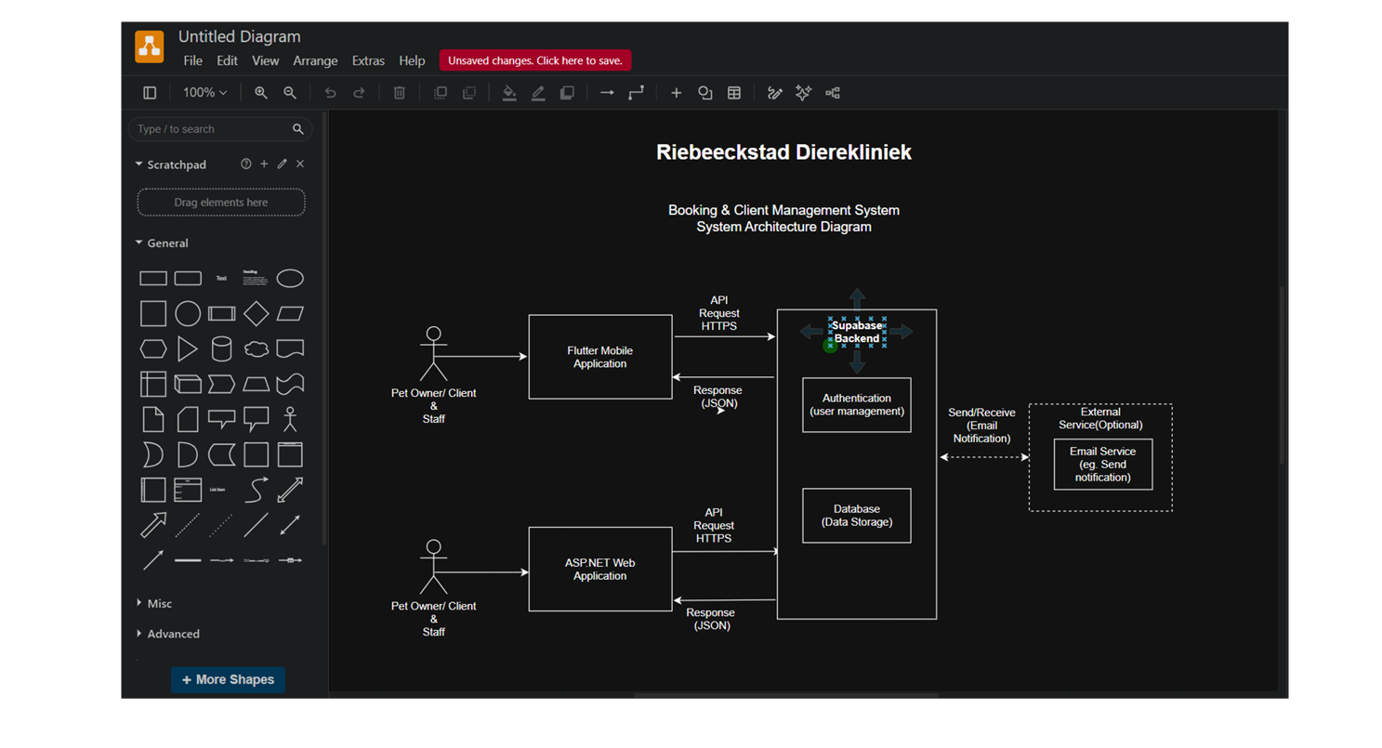
3. System Architecture
Riebeeckstad Dierekliniek • ITC327W Phase 2 • 5

Slide 5
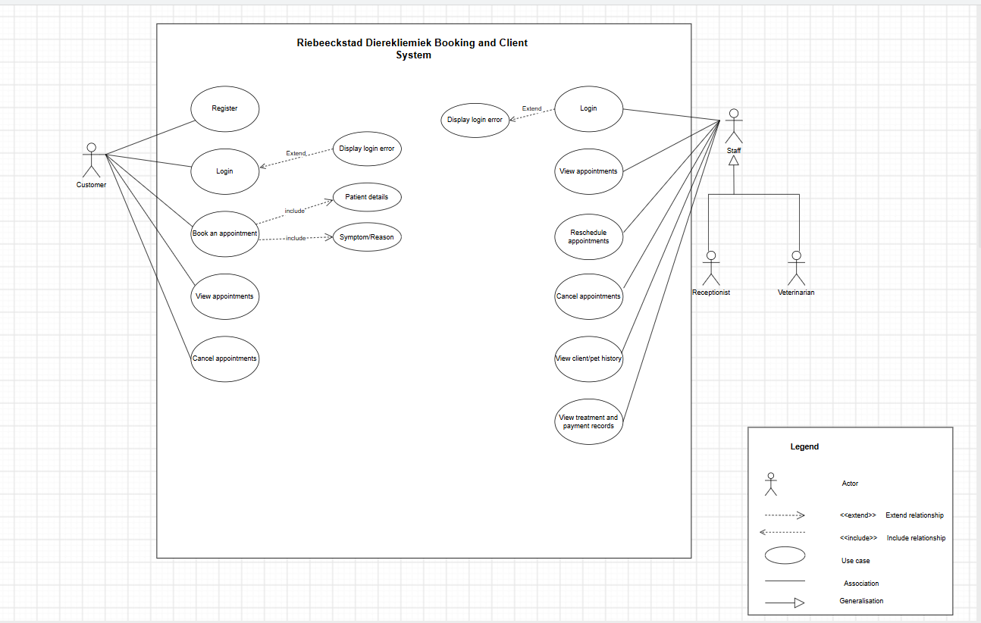
4. Use Case Diagram
Explain
Mention:
• system boundary
• actors
• main use cases
• associations
• include/extend where used
Source link:
https://drive.google.com/file/d/1wY9Z1cAvOy_1QSWmCmXRsKA_Dw9jqXqA/view?usp=sharing
Riebeeckstad Dierekliniek • ITC327W Phase 2 • 6

Slide 6
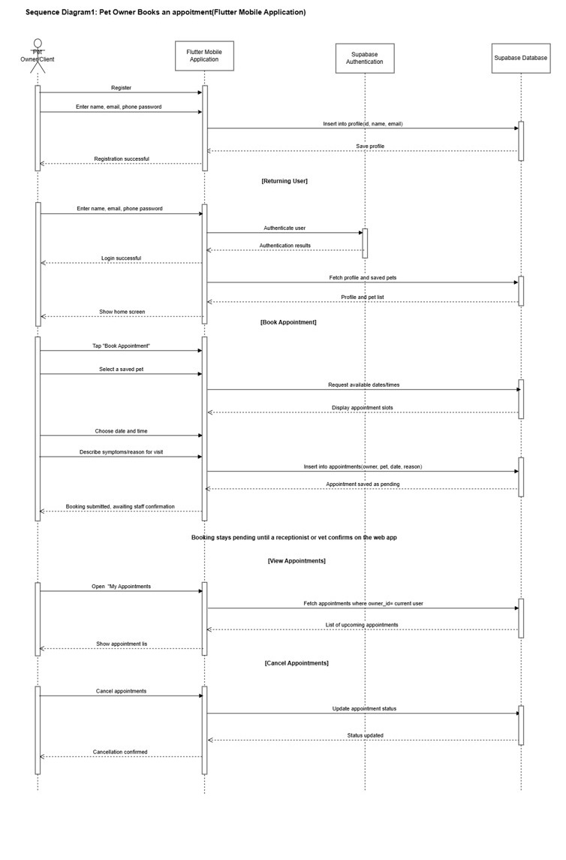
5. Sequence Diagram 1 — Flutter + Supabase
Process
Example process:
Pet Owner → Flutter → Supabase → Appointment record → confirmation
Source link:
https://drive.google.com/file/d/1wBS9P0cflFIfbxg3DXmpL680Jk-80DZv/view?usp=sharing
https://drive.google.com/file/d/1gNzSsPDkSKZodsdLiFaK1ueex8D_RC2r/view?usp=drive_link
Riebeeckstad Dierekliniek • ITC327W Phase 2 • 7

Slide 7
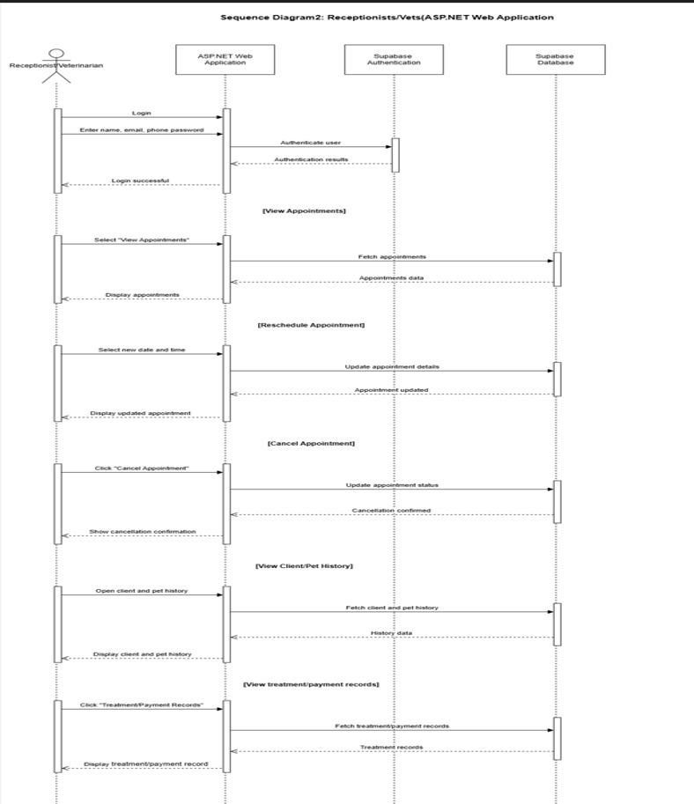
6. Sequence Diagram 2 — ASP.NET + Supabase
Process
Example process:
Staff → ASP.NET → Supabase → appointment data → updated status
Source link:
https://drive.google.com/file/d/1gNzSsPDkSKZodsdLiFaK1ueex8D_RC2r/view?usp=drive_link
Riebeeckstad Dierekliniek • ITC327W Phase 2 • 8

Slide 8
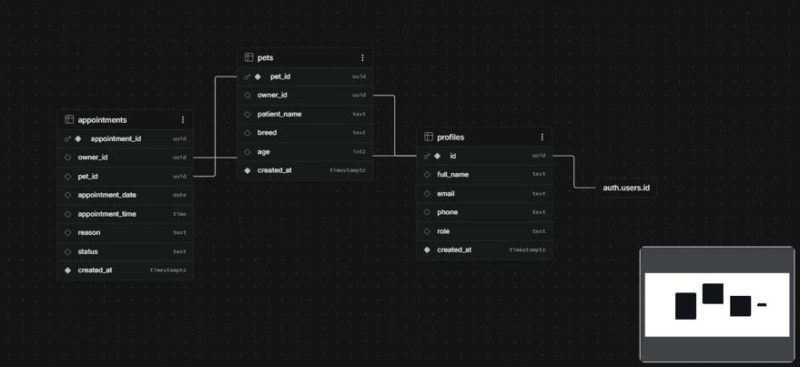
7. ERD & Database Design
• Entities / tables
• Important fields
• Primary keys
• Foreign keys
• Relationships
• Cardinality
• Alignment with the interfaces
Source link:
https://supabase.com/dashboard/project/qgzrolkkggcmfxoycadj/database/schemas
Riebeeckstad Dierekliniek • ITC327W Phase 2 • 9

Slide 9
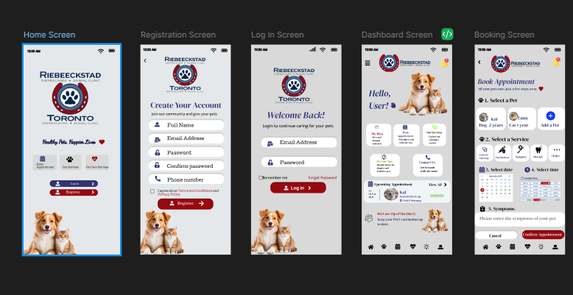
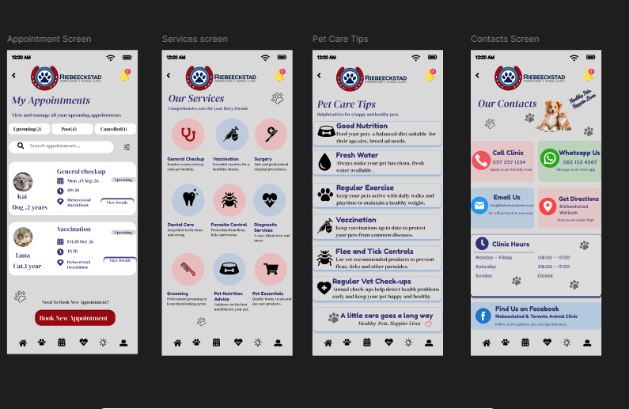
8. Flutter Interface Design
Main client screens
Welcome screen
Register
Log in screen
Dashboard
Book Appointment
My Appointments
Pet Care Tips
Contacts Screen
https://www.figma.com/design/lNBlaus1u17yPdTWfaloDe/Flutter-Mobile-Application?node-id=0-1&t=VwckEj7K93yhxsmO-1
Riebeeckstad Dierekliniek • ITC327W Phase 2 • 10

Slide 10
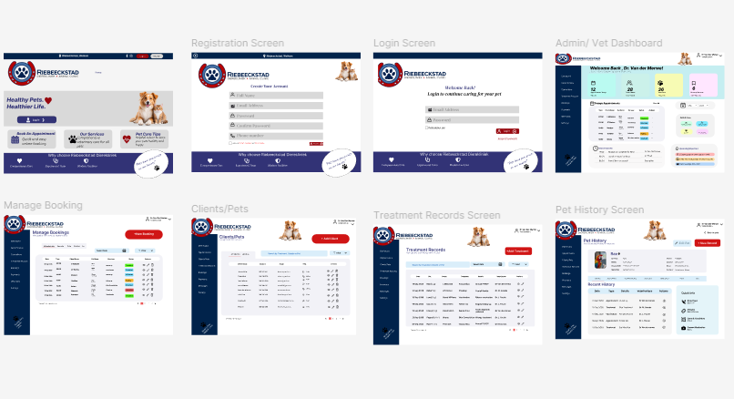
9. ASP.NET Web Interface Design
Main staff pages
Home Screen
Registration Screen
Logun Screen
Admin Dashboard
Manage Booking
Clients/Pets
Treatment Records
Pet History Screen
Design link:
https://www.figma.com/design/jP4MefpntE53Wr4prUKgd7/ASP.NET?node-id=47-2&t=VwckEj7K93yhxsmO-1
Riebeeckstad Dierekliniek • ITC327W Phase 2 • 11

Slide 11
10. Design Alignment
Requirement | Use Case | Sequence | ERD | Interface
FR2 | Book Appointment | Seq. 1 | Appointments | Booking
FR3–FR4 | Capture pet/symptoms | Seq. 1 | Pets/Appointments | Booking
FR6–FR8 | Staff + manage bookings | Seq. 2 | Profiles/Appointments | Staff pages
FR9–FR10 | History + access | Seq. 2 | Profiles/Pets | History
FR11 | Shared backend | Both | All shared data | All connected screens
Riebeeckstad Dierekliniek • ITC327W Phase 2 • 12

Slide 12
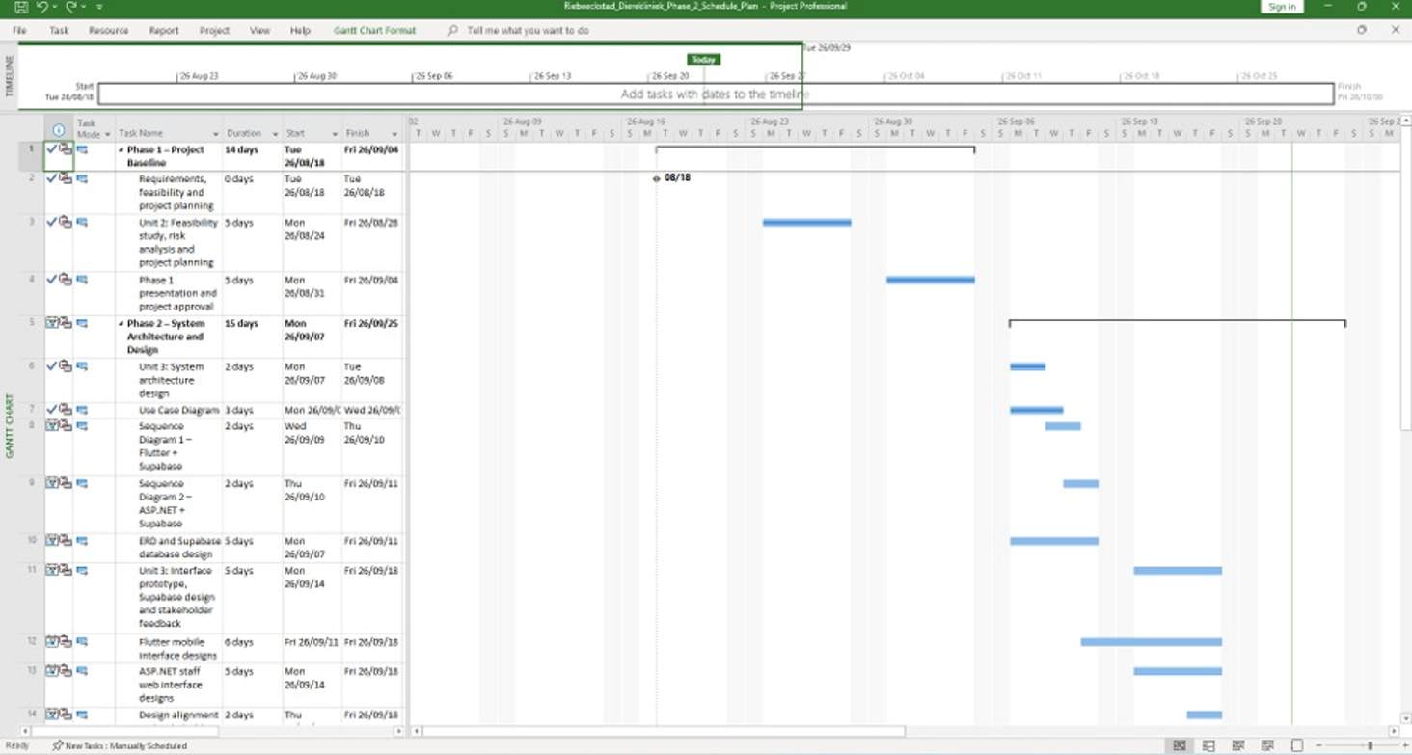
11. Microsoft Project
Microsoft Project screenshot
Riebeeckstad Dierekliniek • ITC327W Phase 2 • 13

Slide 13
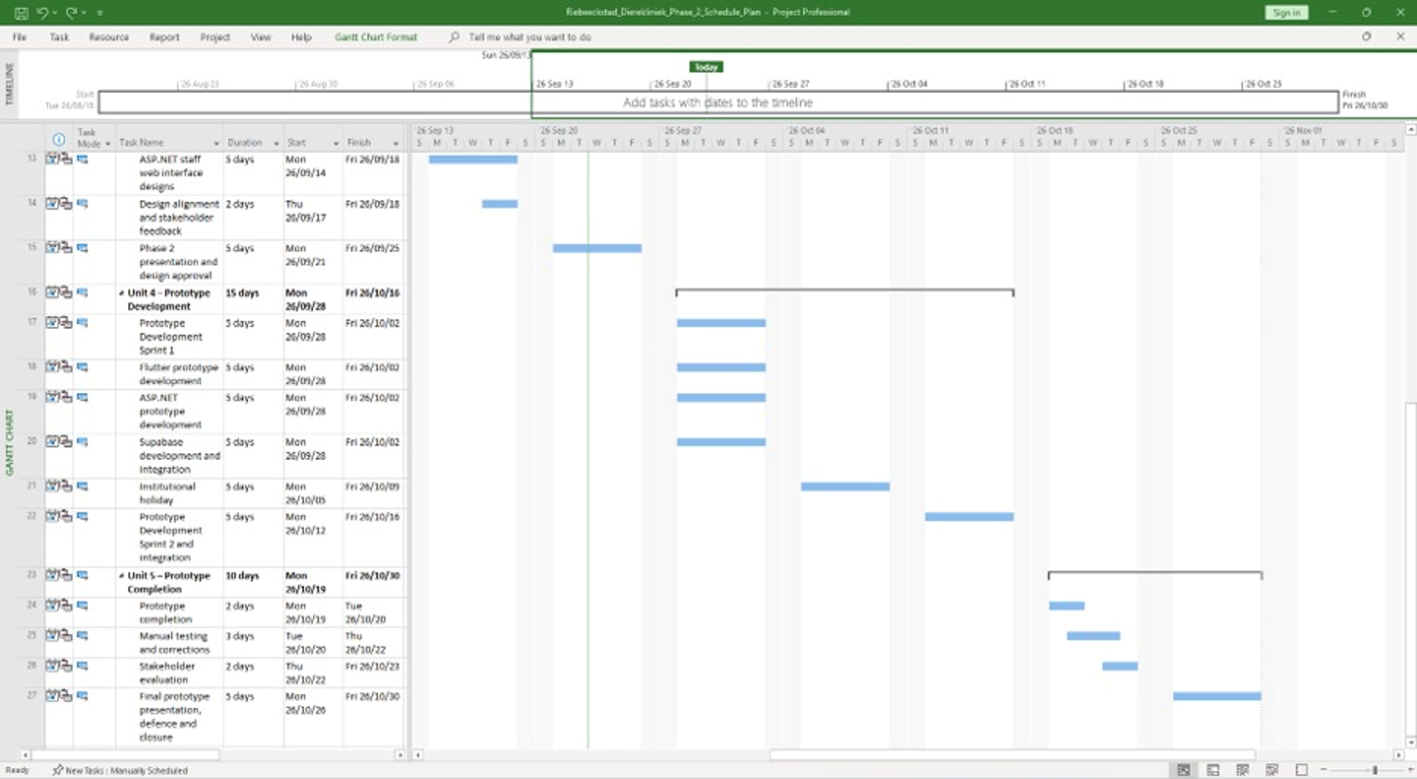
11. Microsoft Project (continued)
Microsoft Project screenshot
Riebeeckstad Dierekliniek • ITC327W Phase 2 • 13

Slide 14
12. Original Design Source Links
Design | Editable source
Architecture | https://drive.google.com/file/d/1LEWTZiz6sWylR_XslPZo1JKkwtjRFu-E/view?usp=sharing
Use Case | https://drive.google.com/file/d/1wY9Z1cAvOy_1QSWmCmXRsKA_Dw9jqXqA/view?usp=sharing
Sequence 1 | https://drive.google.com/file/d/1wBS9P0cflFIfbxg3DXmpL680Jk-80DZv/view?usp=sharing
Sequence 2 | https://drive.google.com/file/d/1gNzSsPDkSKZodsdLiFaK1ueex8D_RC2r/view?usp=drive_link
ERD | https://supabase.com/dashboard/project/qgzrolkkggcmfxoycadj/database/schemas
Flutter UI / Figma | https://www.figma.com/design/lNBlaus1u17yPdTWfaloDe/Flutter-Mobile-Application?node-id=0-1&t=VwckEj7K93yhxsmO-1
ASP.NET UI / Figma | https://www.figma.com/design/jP4MefpntE53Wr4prUKgd7/ASP.NET?node-id=47-2&m=dev&t=VwckEj7K93yhxsmO-1
Riebeeckstad Dierekliniek • ITC327W Phase 2 • 14

Slide 15
THANK YOU
Riebeeckstad Dierekliniek
Booking & Client Management System
Riebeeckstad Dierekliniek • ITC327W Phase 2 • 17

